Slide 1


VISVESVARAYA TECHNOLOGICAL UNIVERSITY
GOVERNMENT ENGINEERING COLLEGE, RAMANAGARA
COMPUTER SCIENCE & ENGINEERING
PROJECT[21CSP76]
MILK QUALITY ANALYZER
Guided By :
Dr. Shabeen Taj G A
Presented by :
Chithrashree P
1GG21CS008

Slide 2
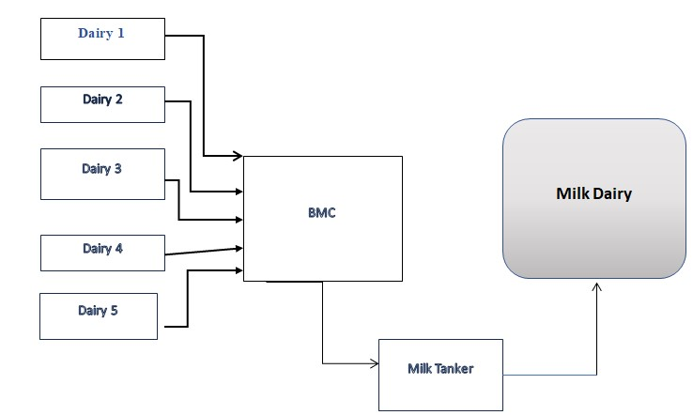
BLOCK DIAGRAM

Slide 3
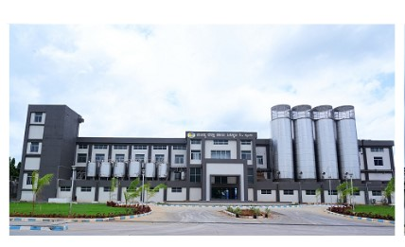
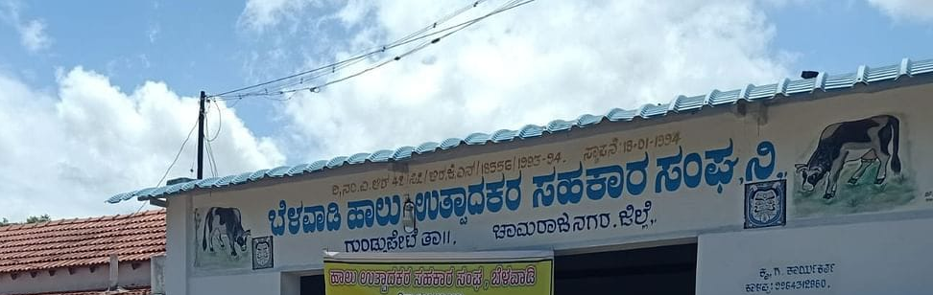
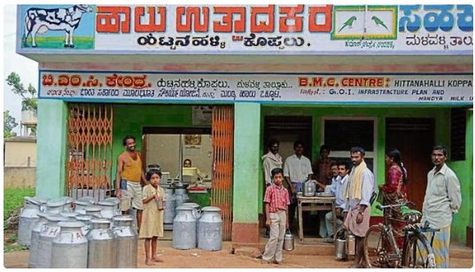
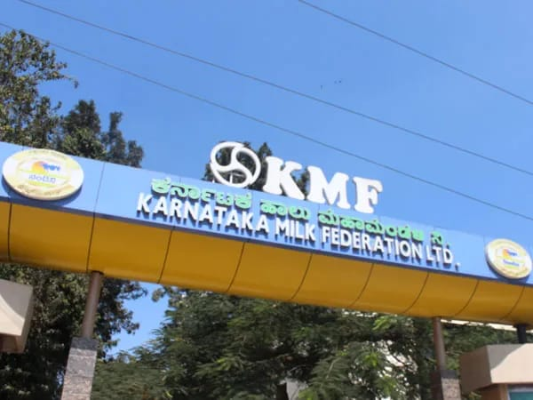
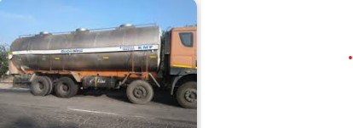

Slide 4
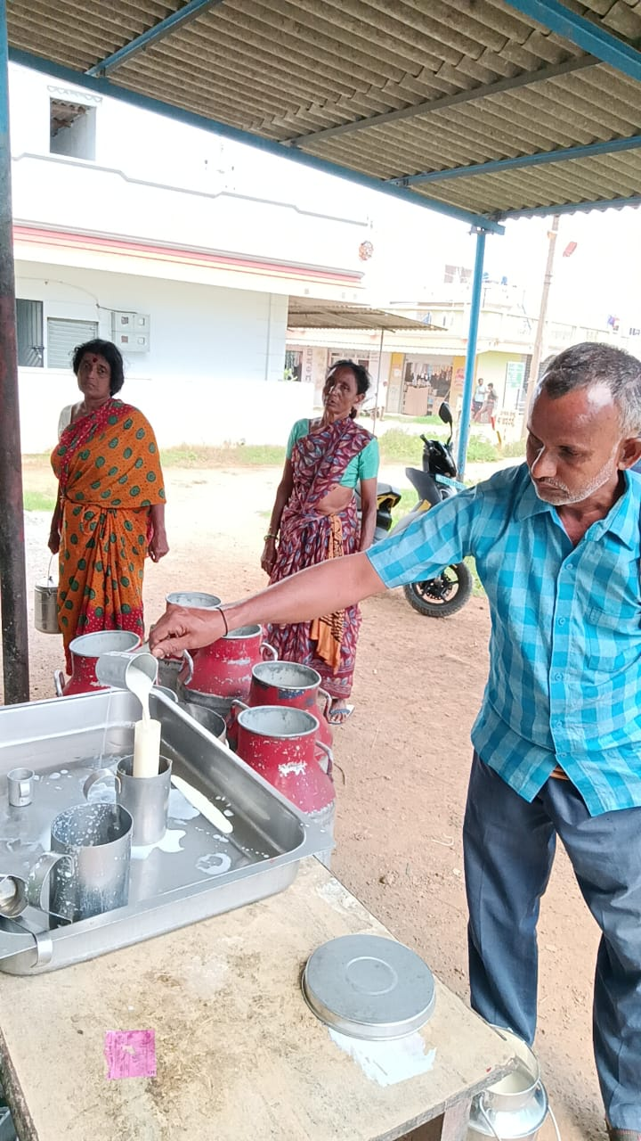
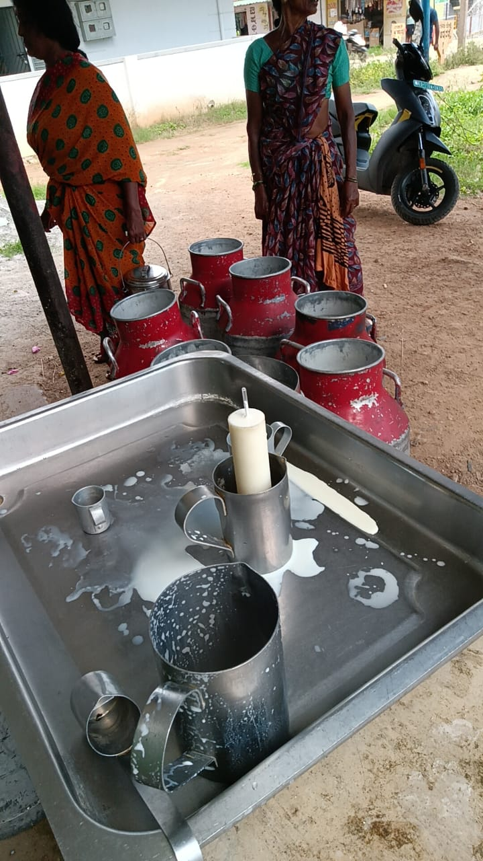
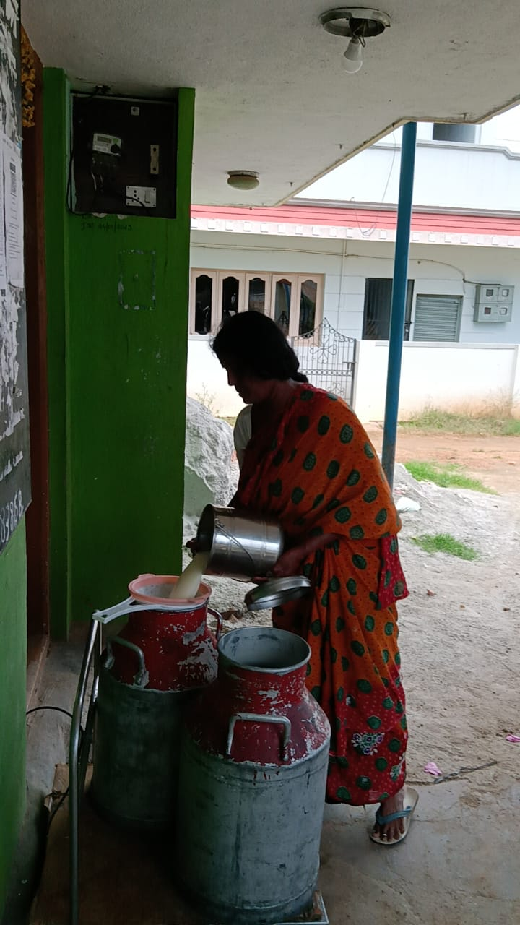
EXAMPLE DAIRY 1 – SRINIVASPURA(v), MANDYA

Slide 5
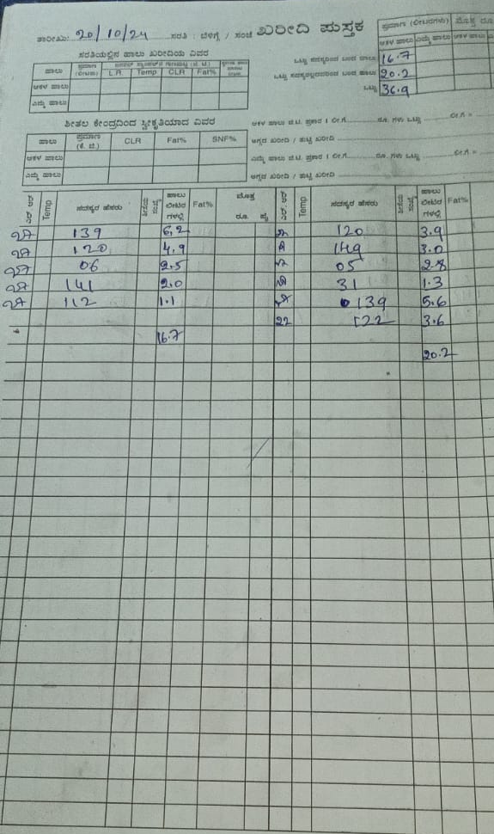
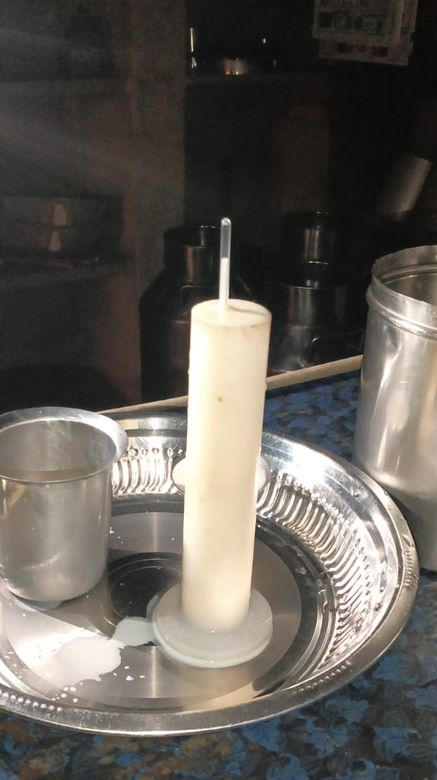
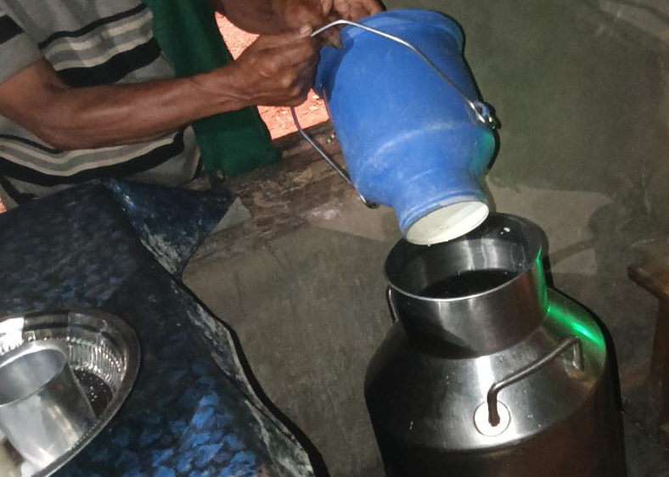
EXAMPLE DAIRY 2 – SIDDAPURA(V), SHIVMOGGA

Slide 6
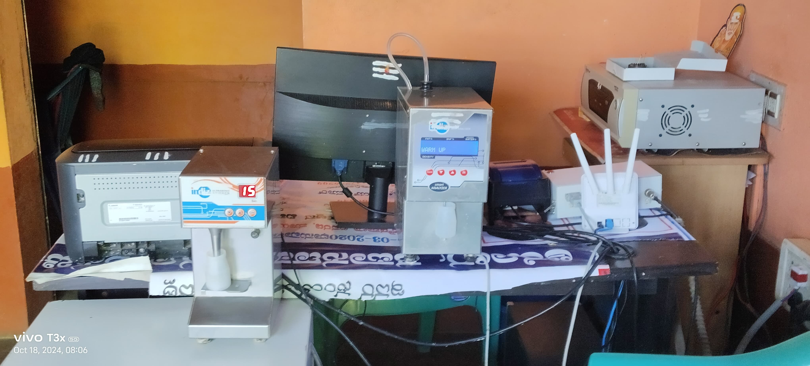
EXAMPLE DAIRY 3- SHANBOGANAHALLI (V), RAMANAGARA

Slide 7
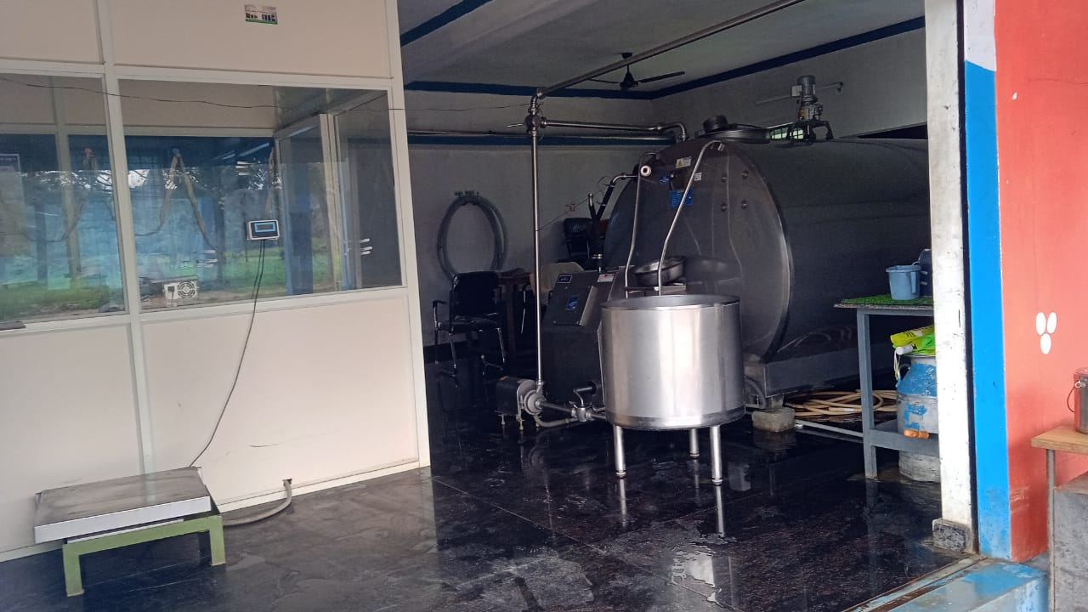
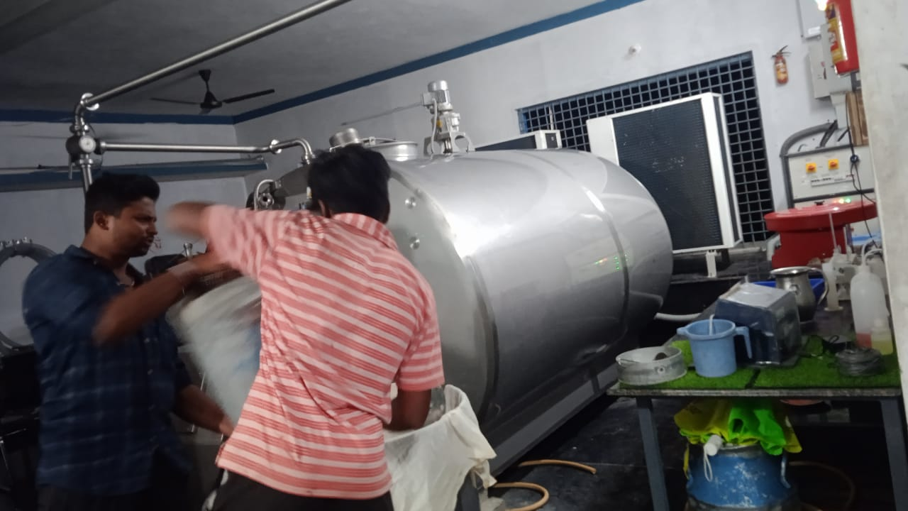
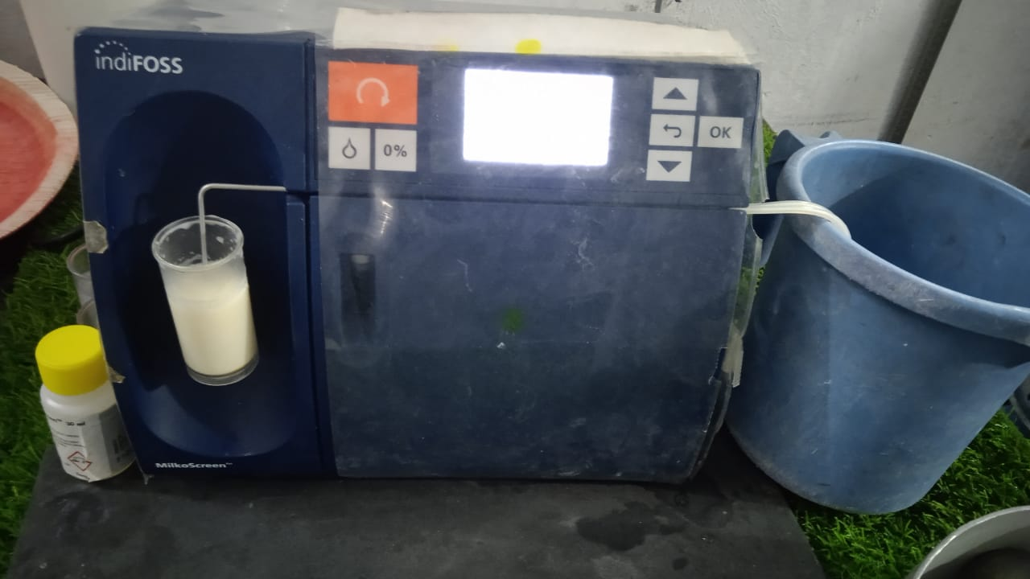
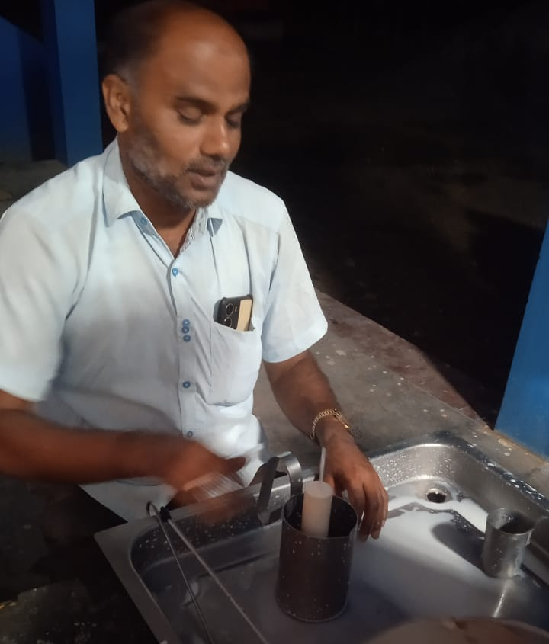
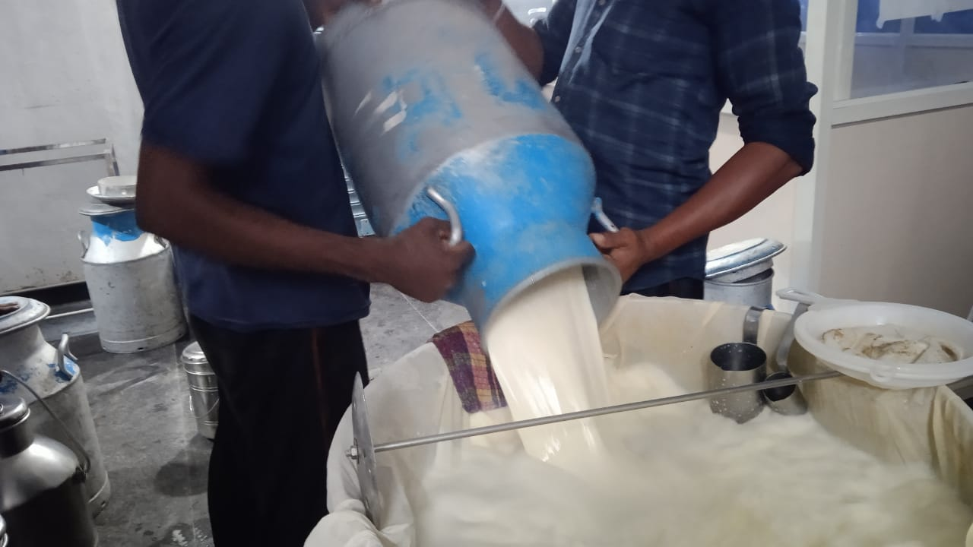
BMC - BOMMANAHALLI(V), MANDYA

Slide 8
THANK YOU
.

